Slide 1
Design Patterns a Presentation by
Sascha Konrad

Slide 2
Overview
Introduction What Is a Design Pattern How to Describe Design Patterns How Design Patterns Solve Design Problems Designing for Change How to Select a Design Pattern Conclusion Two Examples | 3 5 13 16 25 29 32 40

Slide 3
Introduction (1)
Design Patterns Sascha Konrad
Designing object-oriented software is hard, designing reusable
object-oriented software is even harder
Design should be specific to problem, but also general enough
to address future problems and requirements
Expert designers reuse solutions that have worked for them in
the past
→ Recurring patterns of classes and communicating objects
exist in many object-oriented systems

Slide 4
Introduction (2)
Design Patterns Sascha Konrad
If details of previous problems and their solutions are known,
then they could be reused
→ Recording experience in software design for others to use
Design patterns
= important and recurring design in object- oriented systems

Slide 5
What Is a Design Pattern (1)
Design Patterns Sascha Konrad
“Each pattern describes a problem which occurs over and over again in our environment and then describes the core of the solution to that problem, in such a way that you can use this solution a million times over, without ever doing it in the same way twice”
Christopher Alexander, A Pattern Language, 1977

Slide 6
What Is a Design Pattern (2)
Design Patterns Sascha Konrad
A pattern has in general 4 essential elements:
Pattern name
Problem
Solution
Consequences

Slide 7
Pattern Name
Design Patterns Sascha Konrad
A handle used to describe a design problem, its solutions and
its consequences in a word or two
Increases design vocabulary
Makes it possible to design at a higher level of abstraction
Enhances communication
But finding a good name is often hard

Slide 8
Problem
Design Patterns Sascha Konrad
Describes when to apply the pattern
Explains the problem and its context
Might describe specific design problems or class or object
structures
Sometimes contains a list of conditions that must be met
before it makes sense to apply the pattern

Slide 9
Solution
Design Patterns Sascha Konrad
Describes the elements that make up the design, their relation-
ships, responsibilities and collaborations
Doesn’t describe a particular concrete design or implemen-
tation
Abstract description of design problems and how the pattern
solves it

Slide 10
Consequences
Design Patterns Sascha Konrad
Results and trade-offs of applying the pattern
Critical for evaluating design alternatives and for understan-
ding the costs and benefits of applying the pattern
Includes the impacts of a pattern on a system’s flexibility, ex-
tensibility or portability

Slide 11
Design Patterns Are Not
Design Patterns Sascha Konrad
Designs that can be encoded in classes and reused as is (i.e.
linked lists, hash tables)
Complex domain-specific designs (for an entire application or
subsystem)
They are:
“Descriptions of communicating objects and classes that are
customized to solve a general design problem in a particular
context.”

Slide 12
Where Design Patterns
Are Used
Design Patterns Sascha Konrad
Design patterns can be implemented in object-oriented pro-
gramming languages rather than procedural languages.
In procedural languages design patterns for Inheritance, Poly-
morphism and Encapsulation would be defined

Slide 13
How to Describe
Design Patterns
Design Patterns Sascha Konrad
Graphical notation is not sufficient
To reuse design decisions, alternatives and trade-offs that led
to the decisions are important
Concrete examples are also important

Slide 14
A Description Template
Design Patterns Sascha Konrad
Pattern Name and Classification
Intent
Also Known As
Motivation
Applicability
Structure
Participants
Collaborations
Consequences
Implementation
Sample Code
Known Uses
Related Patterns

Slide 15
Classification
Design Patterns Sascha Konrad
Design patterns can be classified by two criteria:
Purpose
What a pattern does (creational, structural or behavioral)
Scope
Whether the pattern applies primarily to classes (static,
compile-time) or to objects (dynamic, run-time)

Slide 16
How Design Patterns Solve
Design Problems
Design Patterns Sascha Konrad
Design patterns solve many of the day-to-day problems object-oriented designers face, and in many different ways. Here are several of these problems and how design patterns solve them.

Slide 17
Finding Appropriate Objects
Design Patterns Sascha Konrad
Hard part of object-oriented design is decomposing a system
into objects
← Encapsulation, granularity, dependency, flexibility,
performance, …
Design Patterns help identifying less obvious abstractions and
the objects that can capture them

Slide 18
Determining Object Granularity
Design Patterns Sascha Konrad
Objects can vary tremendously in size and number
Design patterns address this also i.e. describing how to
decompose an object into smaller objects

Slide 19
Specifying Object Interfaces
Design Patterns Sascha Konrad
An object’s interface characterizes the complete set of
requests that can be sent to the object
A type = particular interface
Subtypes inherit the interfaces of its super types
Run-time association to an object and one of its operations
is known as dynamic binding
→ Polymorphism
Design patterns help defining the interfaces by identifying
the key elements and the kind of data that gets sent across
an interface
A design pattern might also tell what not to put in an inter-
face

Slide 20
Specifying Object Implementations (1)
Design Patterns Sascha Konrad
An object’s implementation is defined by its class
Objects are created by instantiating a class
A subclass inherits the definition of all data and operations
from the parentclass
Abstract classes define common interfaces, but cannot be
instantiated

Slide 21
Specifying Object Implementations (2)
Design Patterns Sascha Konrad
Class vs. Interface Inheritance:
Distinction between class and type
Many design patterns depend on this distinction
Programming to an Interface, not an Implementation:
There two benefits from manipulating objects solely in
terms of the interface defined by abstract classes
  clients remain unaware of the specific types they use, as long as the objects adhere to the interface that clients expect
  Clients remain unaware of the classes that implement these objects, clients only know about the abstract class(es) defining the interface
Creational Patterns assure, that the system is written in terms of interfaces,
not implementations

Slide 22
Putting Reuse Mechanism to Work (1)
Design Patterns Sascha Konrad
Inheritance vs. Composition:
Class inheritance = white-box-reuse = compile-time
Class composition = black-box-reuse = run-time
  Favor object composition over class inheritance
    any object can be replaced at run-time by another
    as long as it has the same type
    → Fewer implementation dependencies
    Object composition helps keeping each class en-
    capsulated and focused on one task
Disadvantage: More objects and the system behavior
will depend on their relationships

Slide 23
Putting Reuse Mechanism to Work (2)
Design Patterns Sascha Konrad
Delegation:
A way of making composition as powerful as inheritance
A receiving object delegates operations to its delegate
→ Easy to compose behaviors at run-time
→ Disadvantage: Makes the software harder to
understand
→ It can make software more complicate
than it simplifies
Inheritance vs. Parameterized Types:
Defining a type without specifying all other types it uses
(i.e. templates in C++)
Also a way to compose behavior in object-oriented systems

Slide 24
Relating Run-Time and Compile-Time Structures
Design Patterns Sascha Konrad
An object-oriented program's run-time structure often bears little resem-
blance to its code structure
  code structure frozen at compile-time
  run-time structure consists of rapidly changing networks of com-
  municating objects
    Aggregation = an object is being part of another object
    Acquaintance = an object merely knows of another object
    With Acquaintance much looser coupling of objects is
    possible
Relationships between objects and their types must be designed with
great care, because they determine how good or bad a run-time
structure is
Many design patterns capture the distinction between compile-time and
run-time structures explicitly

Slide 25
Designing for Change
Design Patterns Sascha Konrad
The key for maximizing reuse lies in anticipating new require-
ments and in designing the system that they can evolve accor-
dingly
System design must take change into its account
Redesign affects many parts of the software system
Design patterns help assuring that a system can change in
specific ways by providing designs that add more flexibility
to software

Slide 26
Design Patterns in Application Programs
Design Patterns Sascha Konrad
In an application program usually internal reuse, maintainabi-
lity and extension are high priorities
Design patterns that reduce dependencies can increase internal
reduce
They can make a system more maintainable when they’re
used to limit platform dependencies and to layer a system
They enhance extensibility by showing how to extend class
hierarchies and how to exploit object composition

Slide 27
Design Patterns in Toolkits
Design Patterns Sascha Konrad
A toolkit is a set of related and reusable classes designed to
provide useful, general-purpose functionality
They are the object-oriented equivalent of subroutine libraries
Toolkit design is harder than application design because they
have to work in many applications
The toolkit writer doesn’t know what those applications will
be or their special needs
  Avoid assumptions that can limit flexibility, applicabili-
  ty and effectiveness

Slide 28
Design Patterns in Frameworks
Design Patterns Sascha Konrad
A framework is a set of operating classes that make up a
usable design for a special class of software
It dictates the architecture of an application
They emphasize design reuse over code reuse
Applications can be built faster and have similar structures
Applications are very dependent on the framework
Design patterns and frameworks are very similar, but they
differ in three major ways
  Design patterns are more abstract then frameworks
  Design patterns are smaller architectural elements than
  frameworks
  Design patterns are less specialized than frameworks

Slide 29
How to Select a Design Pattern
Design Patterns Sascha Konrad
Depending on the catalogue used there are several approaches:
  Consider how design patterns solve design problems
  Scan intent section
  Study how patterns interrelate
  Study patterns of like purpose
  Examine a cause of redesign
  Consider what should be the variable in the design

Slide 30
How to Use a Design Pattern
Design Patterns Sascha Konrad
Once a design pattern is picked the design pattern could be applied:
Read the pattern once through an overview
  Go back and study the structure, participants and collabo-
  ration sections
  Look at the sample code section to see a concrete example
  of the pattern in code
  Choose names for patterns participants that are meaningful
  in the application context
  Define the classes
  Define application-specific names for operations in the
  pattern
  Implement the operations to carry out the responsibilities
  in the pattern

Slide 31
How Not to Use a Design Pattern
Design Patterns Sascha Konrad
They should not be applied indiscriminately
Often they achieve flexibility and variability by introducing
additional levels of indirection
  They complicate design and cost performance
  A design pattern should only be applied when the
  flexibility it affords is actually needed
The consequences sections are helpful when evaluating a
pattern’s benefits and liabilities

Slide 32
Conclusion
Design Patterns Sascha Konrad
Cataloging design patterns is important, it gives standard
names and definitions for the techniques we use
If design patterns in software are not studied it will not be able
to improve them or to come up with new ones

Slide 33
What to Expect from Design Patterns
Design Patterns Sascha Konrad
There are several ways design patterns can affect the way object-oriented software is designed:
  A common design vocabulary
  A documentation and learning aid
  An adjunct to existing methods
  A target for refactoring

Slide 34
A Common Design Vocabulary
Design Patterns Sascha Konrad
Computer scientists name and catalog algorithms and data
structures, but often they don’t name other kinds of patterns
Design patterns provide a common vocabulary to use to com-
municate, document and explore design alternatives
They make a system less complex by making it possible to talk
about it at a higher level of abstraction

Slide 35
A Documentation and Learning Aid
Design Patterns Sascha Konrad
People learning object-oriented programming often complain
that systems use inheritance in convoluted ways and it is diffi-
cult to follow the control flow
  Many of the systems use design patterns, so they become
  easier to understand
Design patterns also make designing software easier by provi-
ding solutions for common problems
Describing a system in terms of the design patterns it uses
makes it easier to understand, otherwise people have to
reverse-engineer to unearth the patterns

Slide 36
An Adjunct to Existing Methods
Design Patterns Sascha Konrad
Object-oriented design methods are supposed to promote good
design, but they haven’t been able to capture the experience of
expert designers
Design patterns provide a way to describe more of the “why”
of a design and not just record the results of decisions
Design patterns are especially useful in turning an analysis
model into an implementation model

Slide 37
A Target for Refactoring (1)
Design Patterns Sascha Konrad
One problem in developing reusable software is that it often
has to be reorganized or refactored, design patterns help
determining how to reorganize a design and reduce the
amount of refactoring
Lifecycle of object-oriented software:
  Prototyping
    Software is brought to life through rapid prototyping and
    incremental changes until it meets an initial set of requi-
    rements and reaches adolescence, the main kind of reuse
    is white-box-reuse
  Expansionary
    The software goes through an expansionary phase to
    meet new requirements until it becomes too inflexible
    and arthritic

Slide 38
A Target for Refactoring (2)
Design Patterns Sascha Konrad
  Consolidation
    Software becomes more general, block-box-reuse
    replaces white-box-reuse
This cycle is unavoidable, but using design patterns prevents later refactoring
  Refactoring = Tearing apart classes into special- and gene-
  ral-purpose components, moving operations
  up or down the class hierarchy and rationali-
  zing to reorganize software in the consolida-
  tion phase

Slide 39
A Parting Thought
Design Patterns Sascha Konrad
“It is possible to make buildings by stringing together patterns, in a rather loose way. A building made like this, is an assembly of patterns. It is not dense. It is not profound. But it is also possible to put patterns together un such a way that many patterns overlap in the same physical space: the building is very dense; it has many meanings captured in a small space; and through this density, it becomes profound.”
Christopher Alexander, A Pattern Language, 1977

Slide 40
Two Examples
Design Patterns Sascha Konrad
Two design patterns and an example how they could be used:
  Singleton
    Ensure a class only has one instance and provide a
    global point of access to it
  Observer
    Define a one-to-many dependency between objects so
    that when one object changes state, all its dependents are
    notified and updated automatically

Slide 41
Singleton (1)
Design Patterns Sascha Konrad
It’s important for some classes to have exactly one instance
The best solution is to make the class itself responsible for
keeping track of its sole instance
The class can ensure that no other instance can be created by
intercepting requests to create new objects and it can provide
a way to access the instance

Slide 42
Singleton (2)
Design Patterns Sascha Konrad
The following sheets show an implementation of a scheduler
It was used to simulate parallelism in a system to avoid
communication- and synchronization problems
It activates specific methods of objects periodically
Only one instance of the class must exist
To ensure this the singleton pattern is used

Slide 43
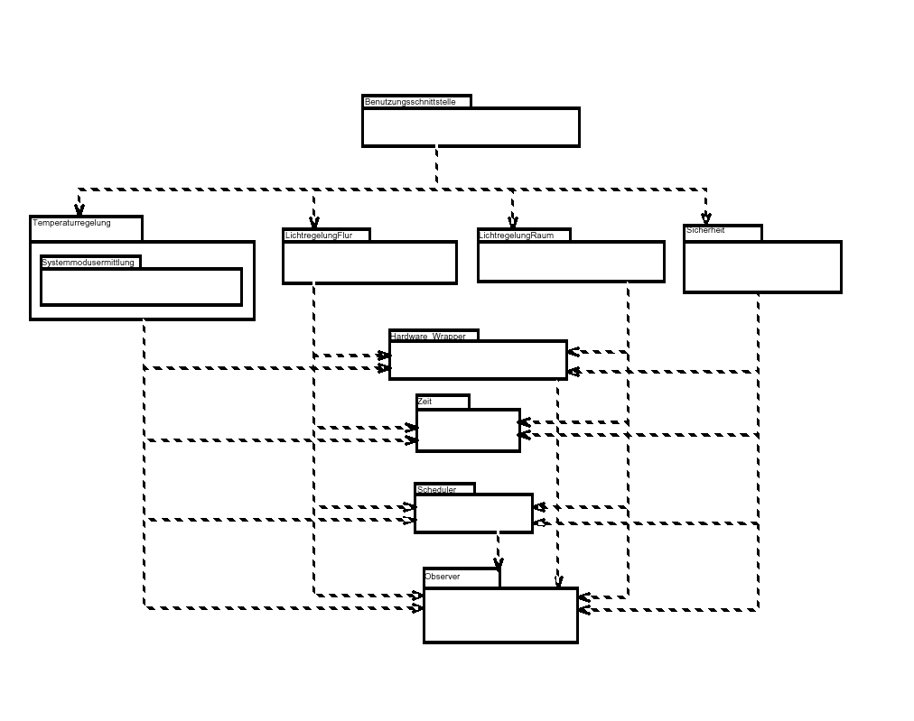
Singleton (3)
Design Patterns Sascha Konrad

Slide 44
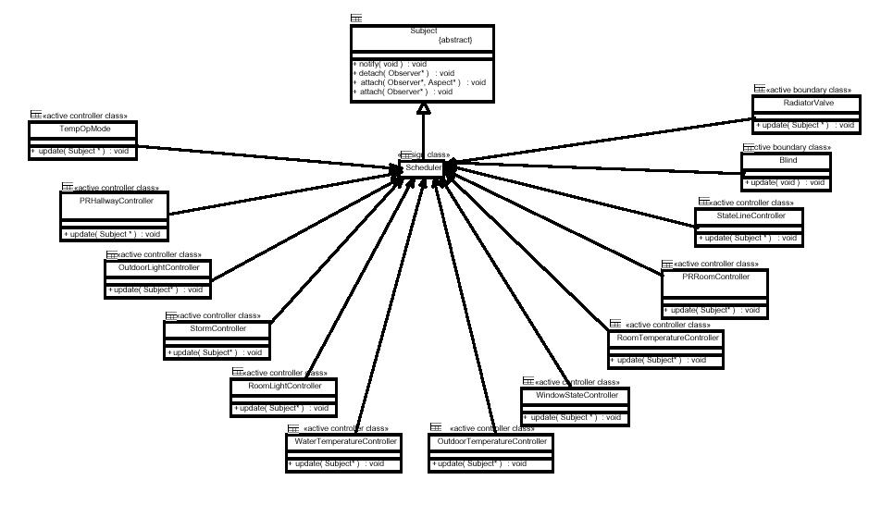
Singleton (4)
Design Patterns Sascha Konrad

Slide 45
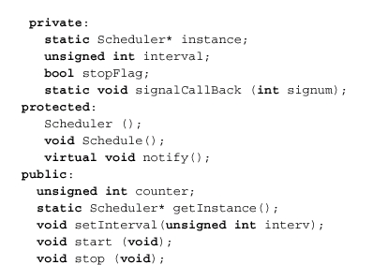
Singleton (5)
Design Patterns Sascha Konrad
Declaration:

Slide 46
Singleton (6)
Design Patterns Sascha Konrad
The singleton pattern makes the sole instance a normal in-
stance of Scheduler, but that class is written that only one
instance can ever be created
This is done be hiding the operation that creates the
instance behind a static member function
Through getInstance() the only instance of the class can be
accessed

Slide 47
Observer (1)
Design Patterns Sascha Konrad
A common side-effect of partitioning a system into a col-
lection of cooperating classes is the need to maintain con-
sistency between related objects
The observer pattern describes how to establish these rela-
tionships
The key objects are:
  Subject
  A subject may have any number of depending observers
  Observer
  Observers are notified when the subject undergoes a
  change of state and then they will query the subject to
  synchronize its states with the subject’s state

Slide 48
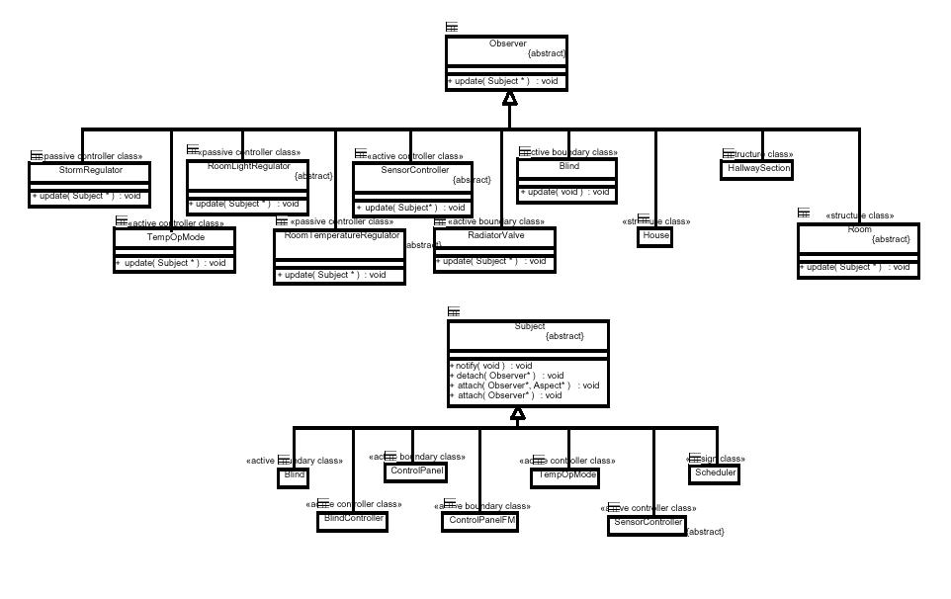
Observer (2)
Design Patterns Sascha Konrad

Slide 49
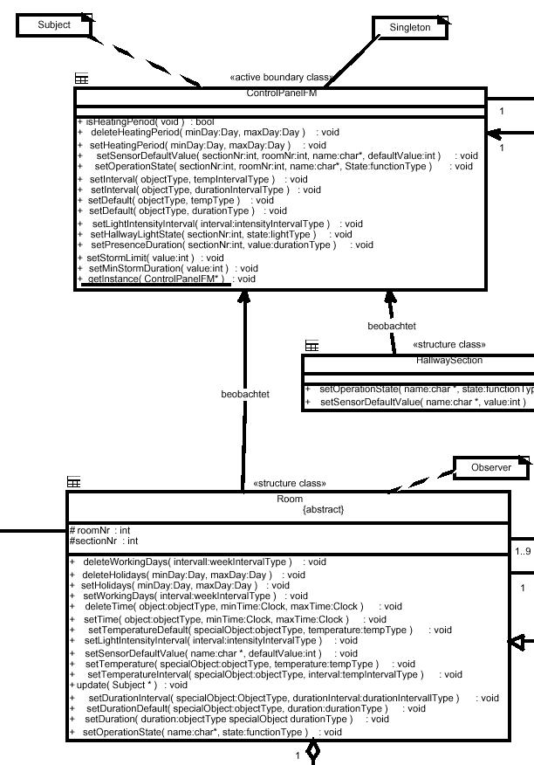
Observer (3)
Design Patterns Sascha Konrad
An example:
The class Room is observing
the class ControlPanelFM
If something is set in
ControlPanelFM Room is in-
formed through its update-
function
ControlPanelFM knows its
observers because it provides
the interface for attaching and
detaching Observer objects

Slide 50
Observer (4)
Design Patterns Sascha Konrad
The observer pattern gives the possibility to vary subjects and
observers independently
Subjects can be reused without reusing the observers and vice
versa
Observers can be added without modifying the subjects
Abstract coupling between subject and observers
Support for broadcast communication
But unexpected updates possible (a simple operation can cause
a cascade of updates)

